Slide 1

Dayalbagh Educational Institute
Major Project Presentation
Real Time Hand Gesture Detection
Submitted by: Kapil Srivastava, Kartikeya
Roll No. : 1700644, 2002051
Branch : Civil CS
Under the supervision of Ms. Priyanka Chauhan
(Department of Civil Engineering)

Slide 2
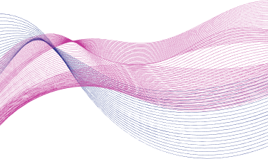
OVERVIEW
Real time hand gesture detection is a software/program that is used to detect the hand gestures made by the user and convert it into meaning texts/sentences. These programs use the algorithms of Machine Learning(ML), Deep Learning(DL), Natural Language Processing(NLP), etc.
The future of this kind of project holds a lot of potential that can be used to transform the lives of many specially abled persons. As the technologies in the fields are advancing, a future using these types of tools has become more conceivable than before.

Slide 3

The primary objective of hand gesture recognition softwares revolves around the improved communication.
Recognition : First objective of these softwares deals with the recognition of such gestures, there are a lot of gestures meaning different things. so, a more universal meaning is required to be associated with them and recognized by the software.
Language processing : After the recognition part, comes the sentence forming part, meaningful sentences are created after collecting the key words from the recognition part.
Primrary
OBJECTIVES

Slide 4
Introduction to tools
Python programming
LabelImg
Jupyter notebook
Open CV
Tensorflow
Tensorflow Object Detection API

Slide 5
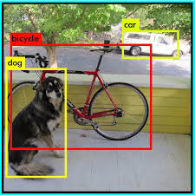
Tensorflow object detection API
The TensorFlow Object Detection API is an open-source framework built on top of TensorFlow that makes it easy to construct, train and deploy object detection models. There are already pre-trained models in their framework which are referred to as Model Zoo.
Given an image or a video stream, an object detection model can identify which of a known set of objects might be present and provide information about their positions within the image.

Slide 6
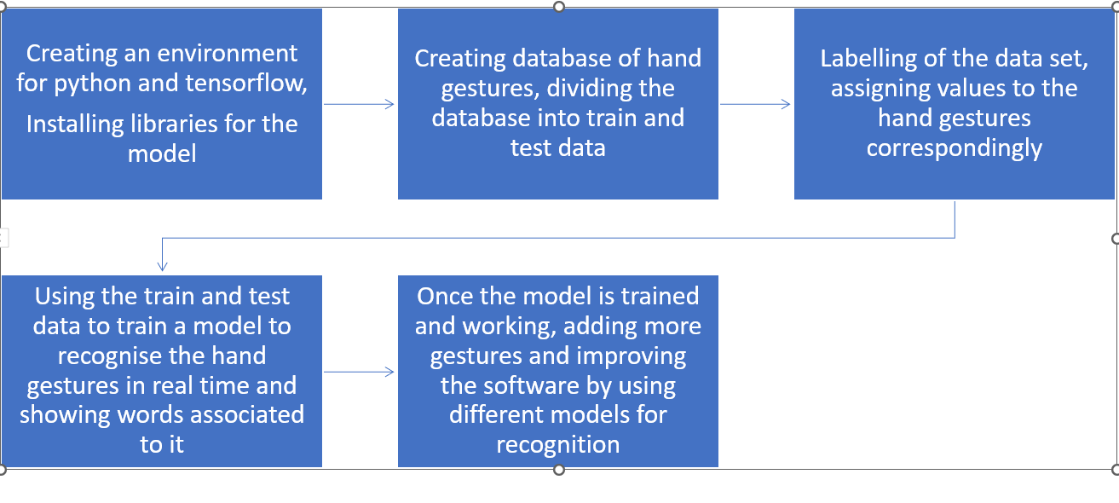
Flow chart of the model

Slide 7

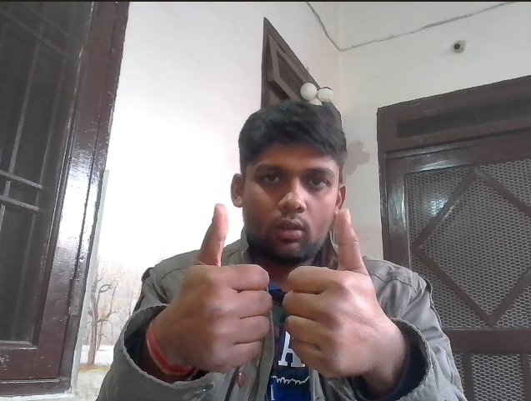
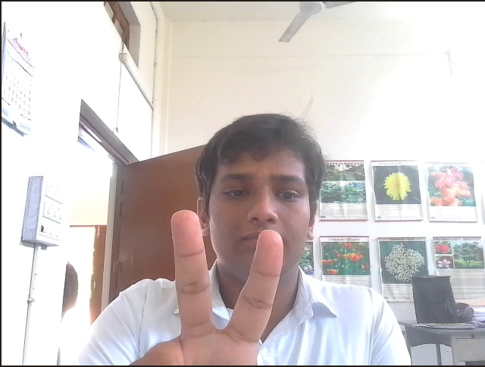

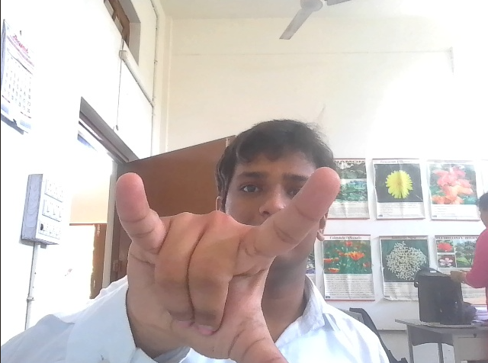
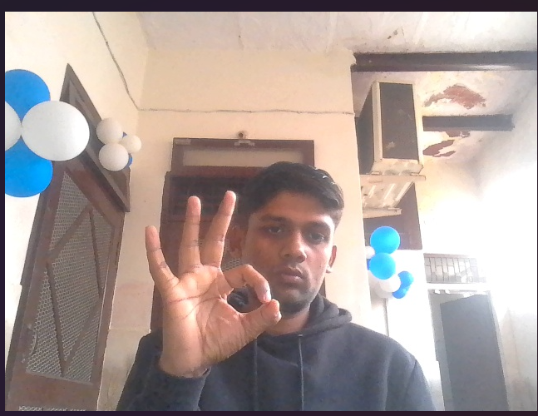
Collecting Images using Open CV lib

Slide 8
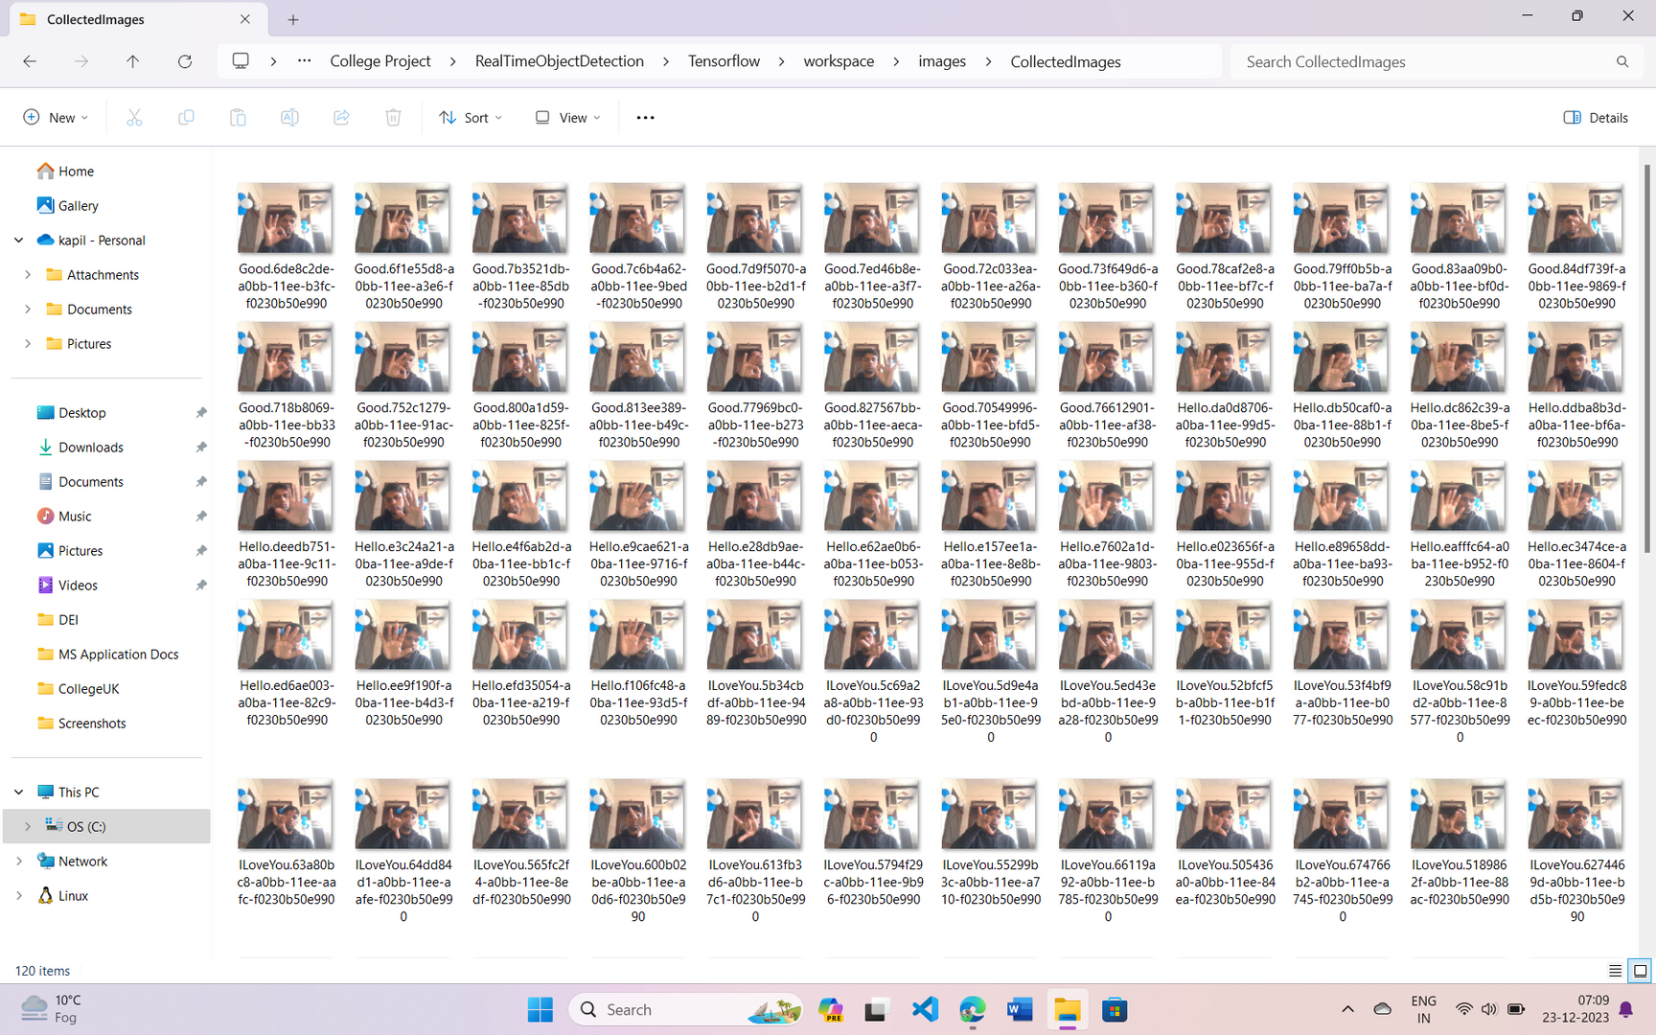
Collecting Images using Open CV lib

Slide 9
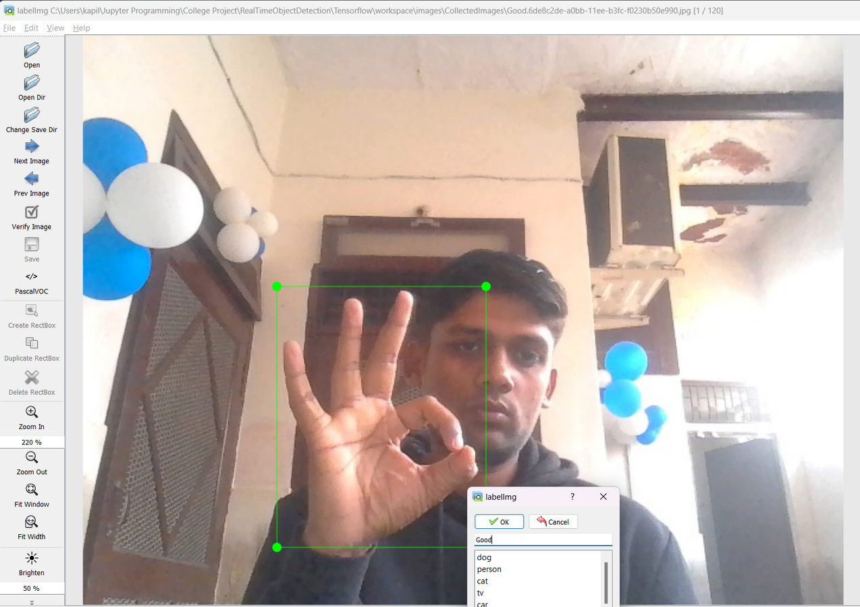
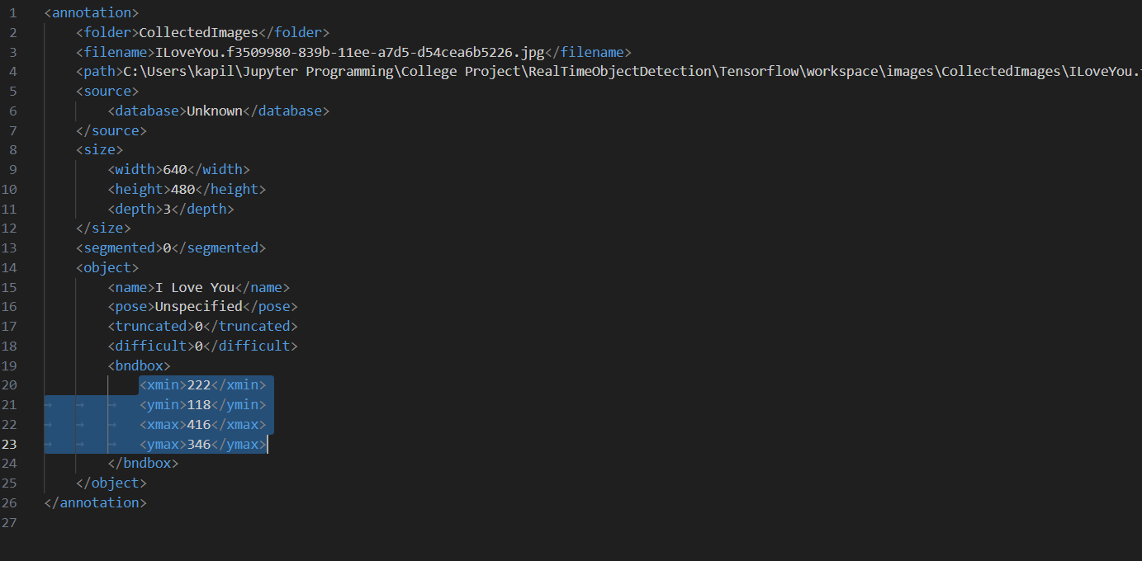
Labelling of images using labelimg package in python

Slide 10
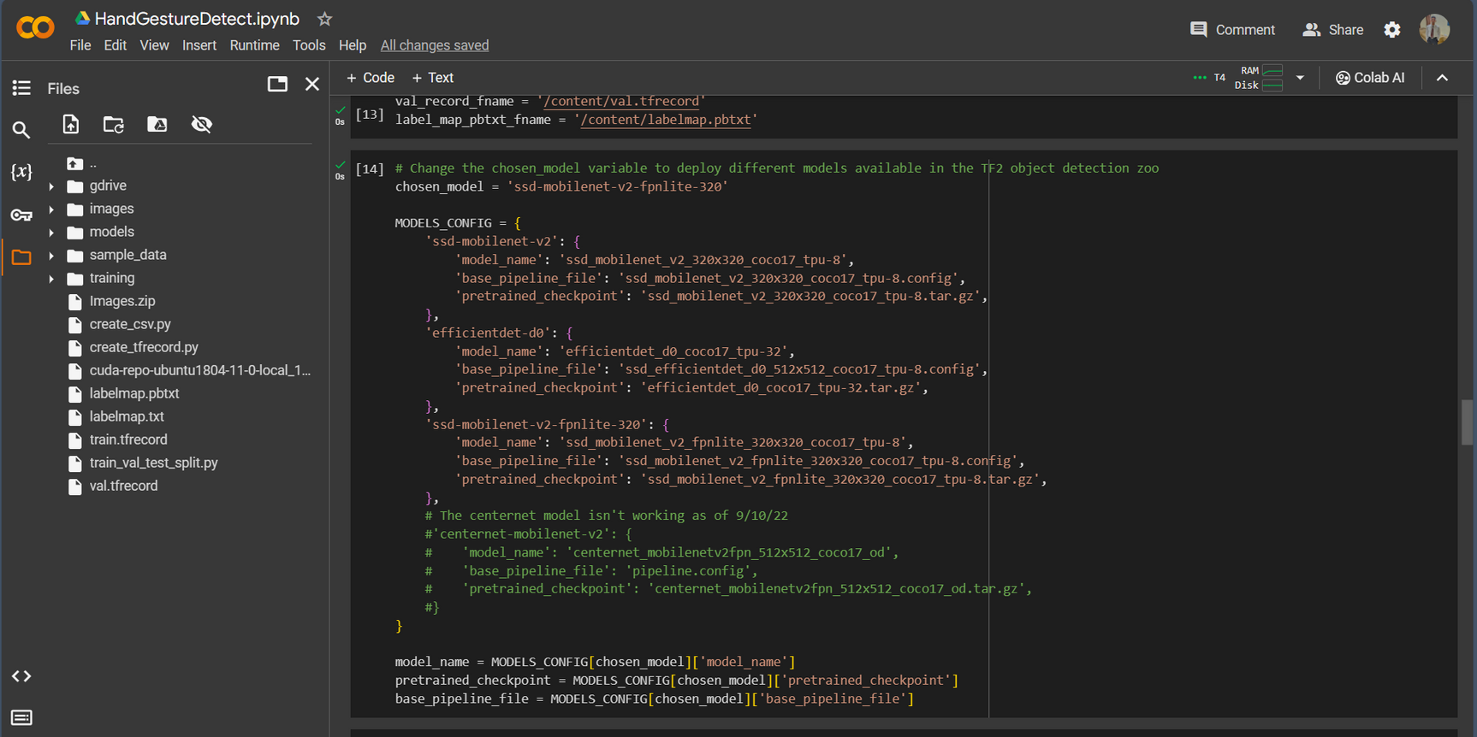
Model Training

Slide 11
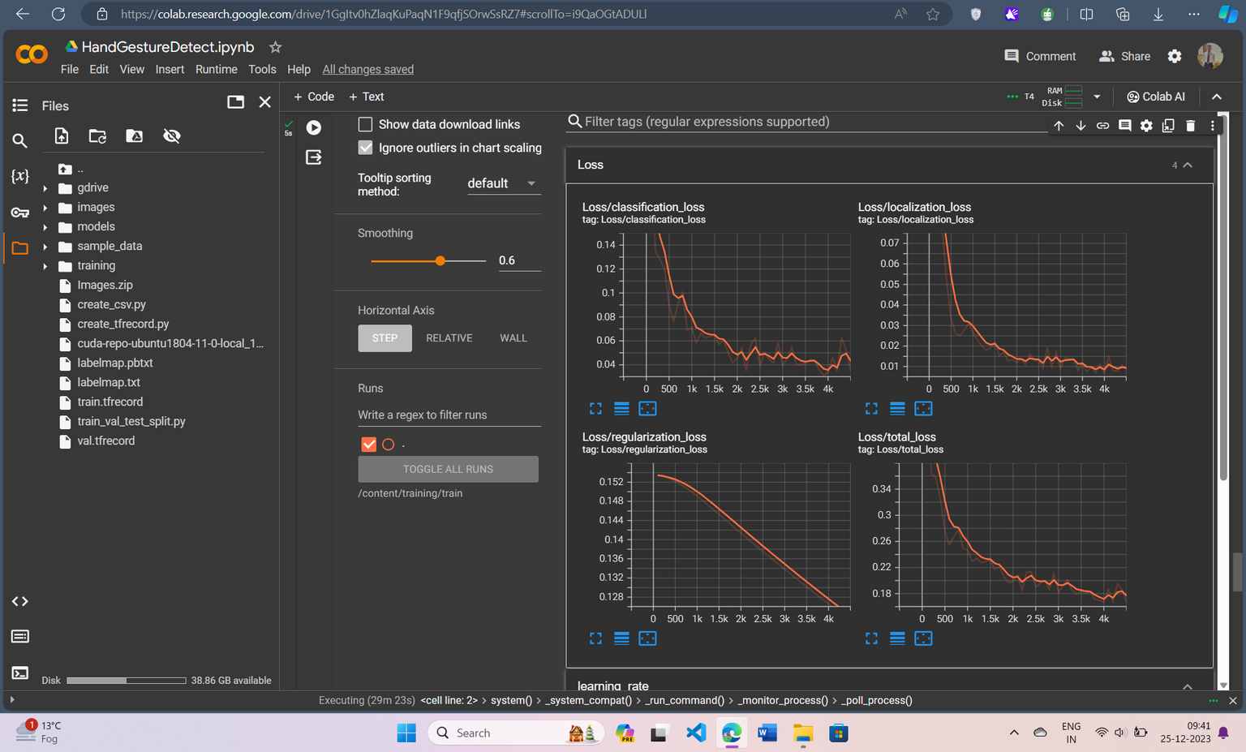
Model Training

Slide 12
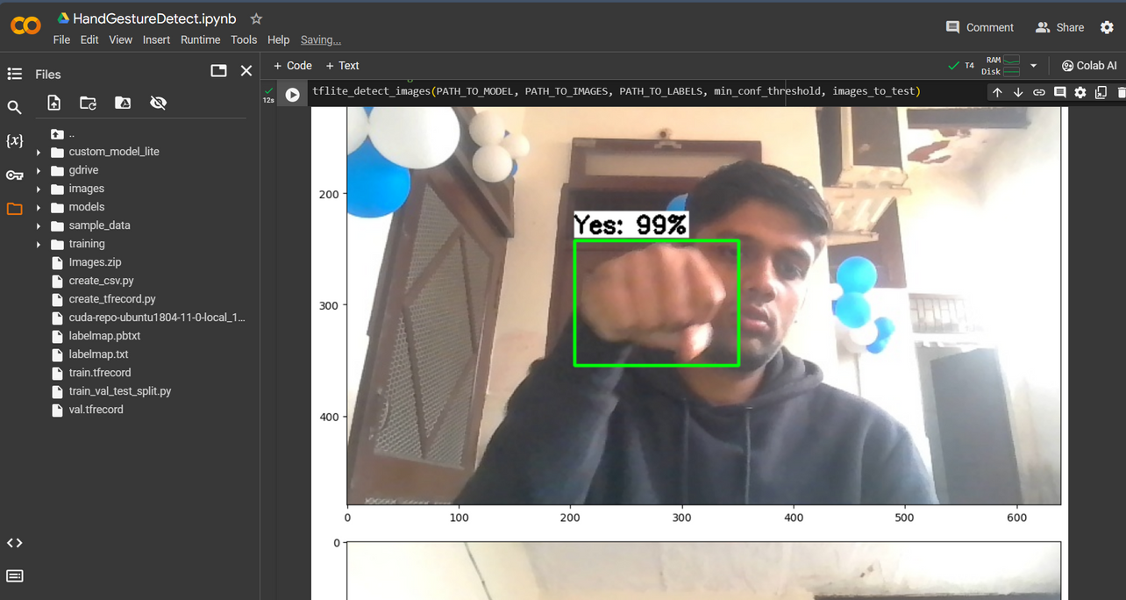
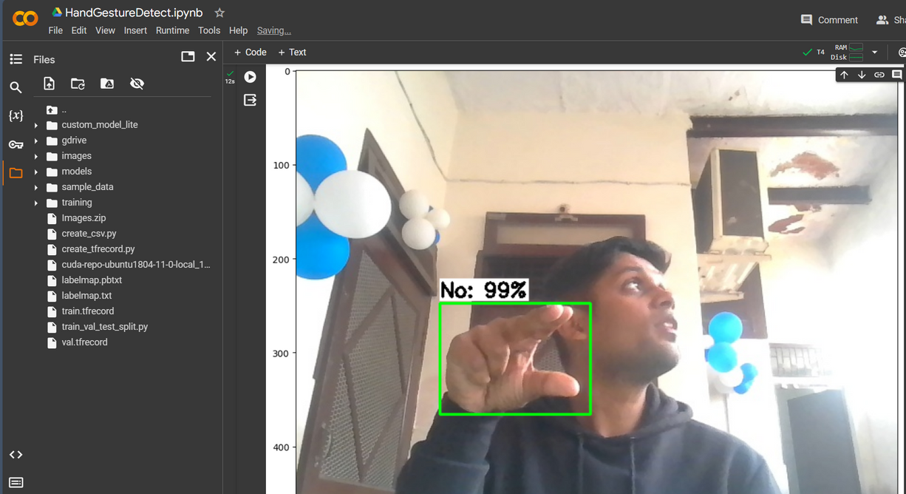
Model Testing

Slide 13
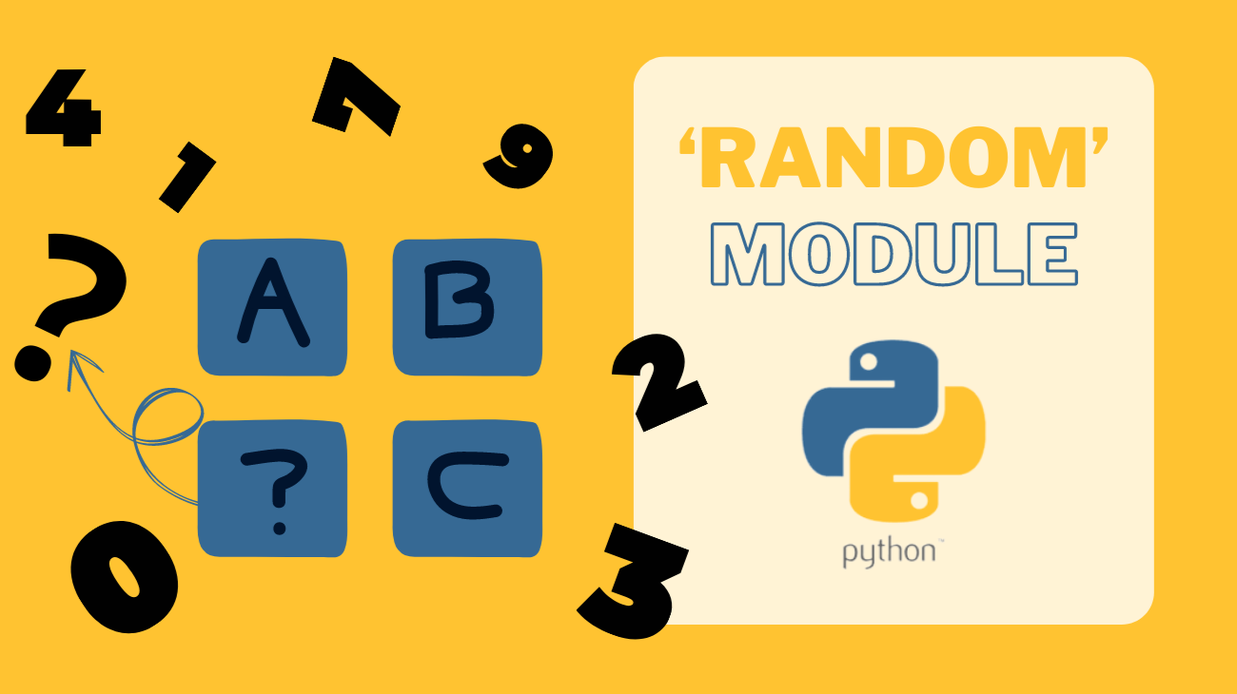
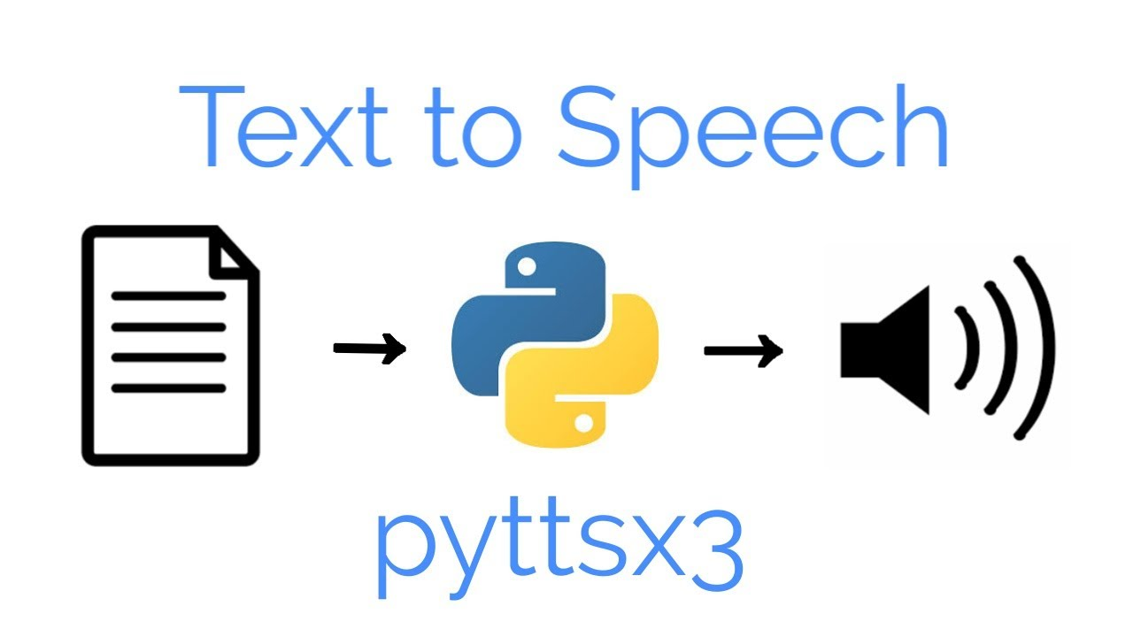

Sentence Formation
Libraries used to form sentences are as follows:
import random
import cv2
from tkinter import *
from tkinter.ttk import *
import pyttsx3

Slide 14
Issues encountered
Model Compatibility Issue
Universal Dataset Unavailability : For Hand Gesture Detection, there are very less amount of data available. To overcome this problem, a universal dataset needs to be created.
Multiple Overlapping Classes : As observed there can be multiple hand gestures that are very similar to each other, Hence, detection with accuracy becomes impossible.
Integration with NLP : Integration of this algorithm with the algos of NLP is quite a difficult task.
Increase various functionalities like sentence formation, model accuracy, text-to-speech conversion will require in-depth knowledge of the used concepts.

Slide 15
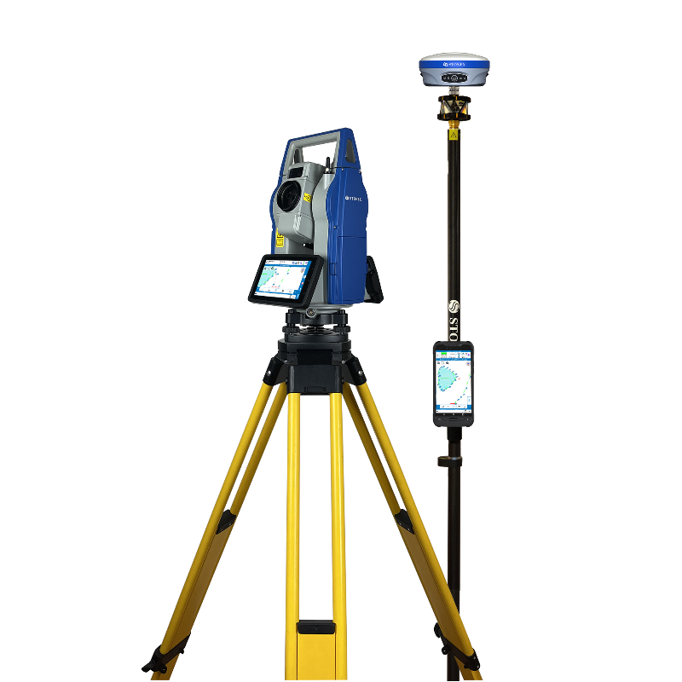
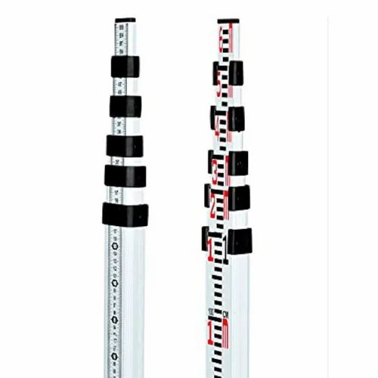
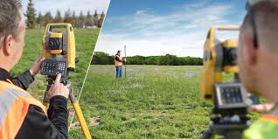
Potential of the project
This project can prove to be a great asset in the coming era of technology, as the tech will advance, the underlying algorithms associated with this project will also improve.
It can be used in construction sites, where people need to interact with hand gestures.

Slide 16
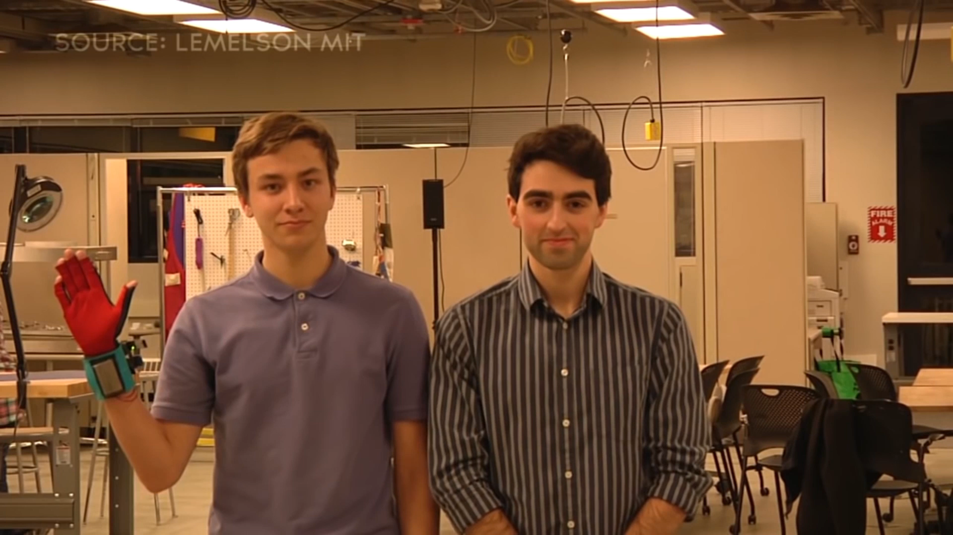
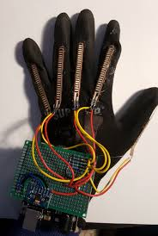
Potential of the project
In future, a glove can be made which converts hand gestures into speech.

Slide 17
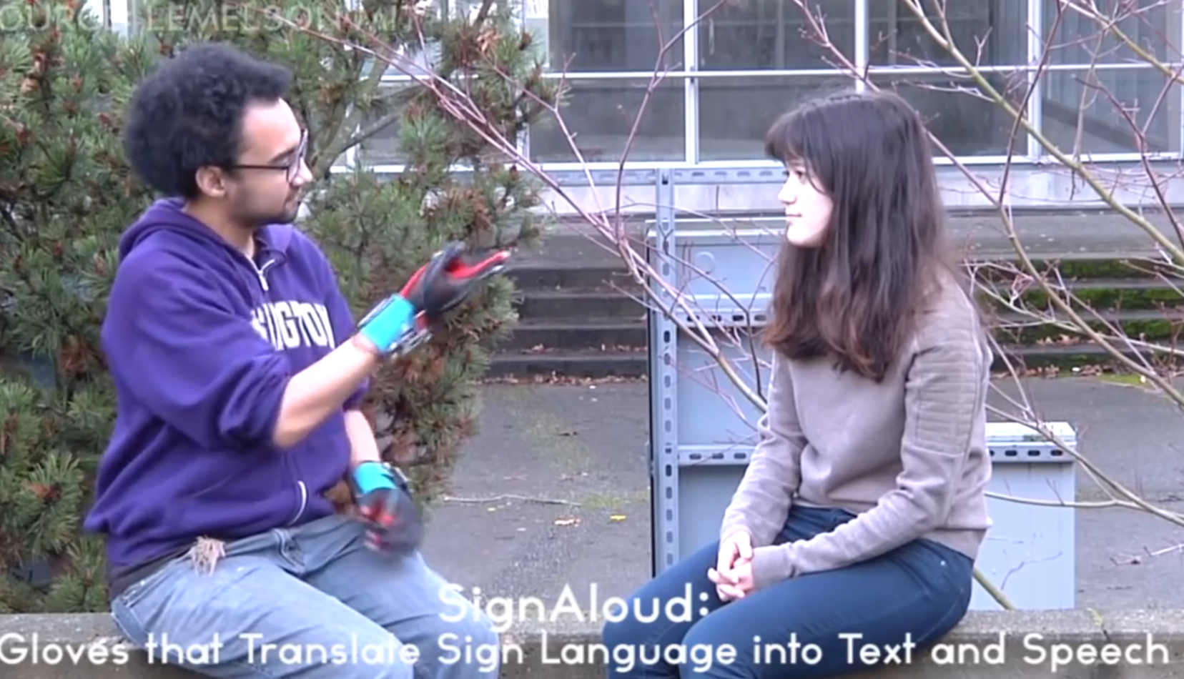
Potential of the project
It can be a very handy tool for the specially abled peoples, but the main problem is scalability issues and the efficiency of these recognition techniques.

Slide 18
References
Sharma, Bhuvi. "Gesture Recognition Using Tensor flow, Opencv and Python." Amity Journal of Computational Sciences 7.1 (2023).
Srivastava, Sharvani, et al. "Sign language recognition system using TensorFlow object detection API." International conference on advanced network technologies and intelligent computing. Cham: Springer International Publishing, 2021.
Abhishek, B., et al. "Hand gesture recognition using machine learning algorithms." Computer Science and Information Technologies 1.3 (2020): 116-120.
Aggarwal A, Bhutani N, Kapur R, Dhand G, Sheoran K. Real-time hand gesture recognition using multiple deep learning architectures. Signal, Image and Video Processing. 2023 Nov;17(8):3963-71.
Abhishek B, Krishi K, Meghana M, Daaniyaal M, Anupama HS. Hand gesture recognition using machine learning algorithms. Computer Science and Information Technologies. 2020 Nov 1;1(3):116-20.

Slide 19


THANK YOU
kapilsrivastava2312@gmail.com
kartikeya2002agra@gmail.com

